Slide 1

DevOps, Continuous Integration, the Cloud, and Docker
Dan Nordquist
Solutions Architect,
Magenic
Level: Intermediate

Slide 2

CONTAINS 18 19 20 NEW SONGS
By Source (WP:NFCC#4), Fair use, https://en.wikipedia.org/w/index.php?curid=49976778
https://www.reddit.com/r/hiphopheads/comments/4cnbx0/the_life_of_pablo_has_been_updated_again/
https://www.inverse.com/article/12993-kanye-west-s-best-the-life-of-pablo-changes
https://www.reddit.com/r/hiphopheads/comments/4a8y1w/the_life_of_pablo_is_being_updated_on_tidal_right/
http://www.ew.com/article/2016/04/01/kanye-west-life-pablo-changes

Slide 3
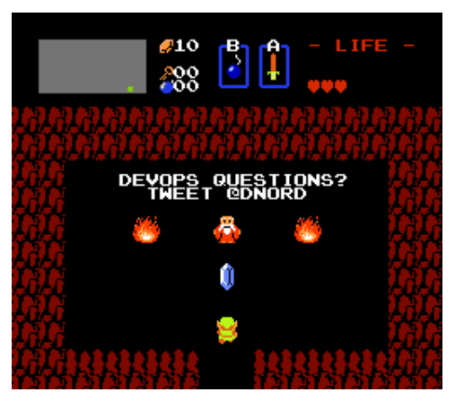

Slide 4
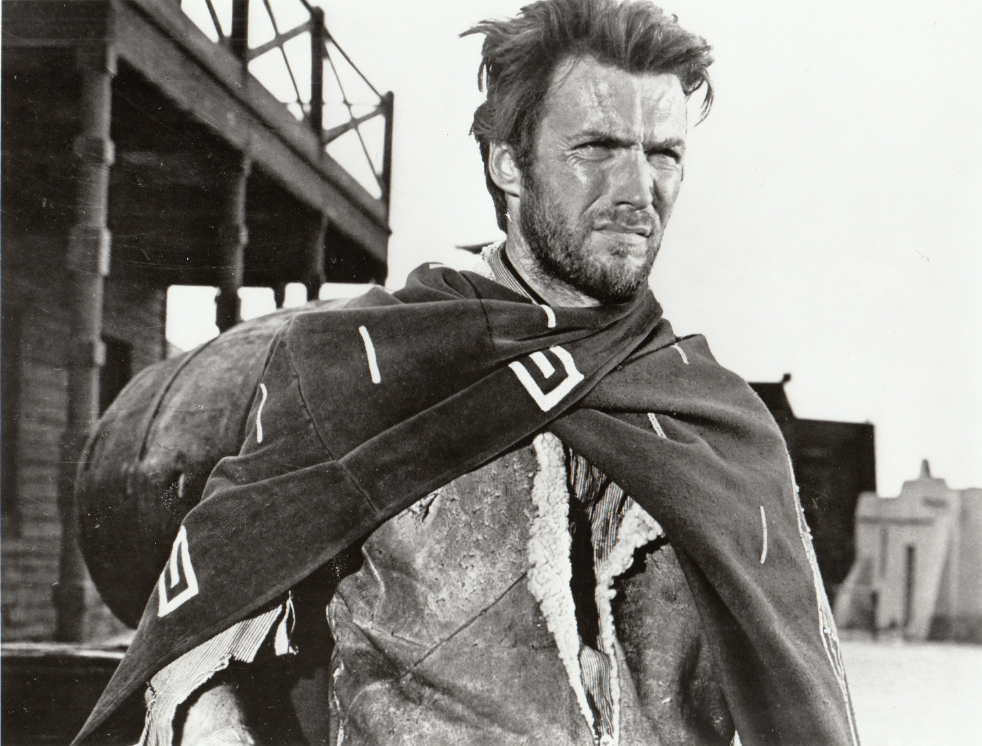
https://en.wikipedia.org/wiki/Clint_Eastwood

Slide 5
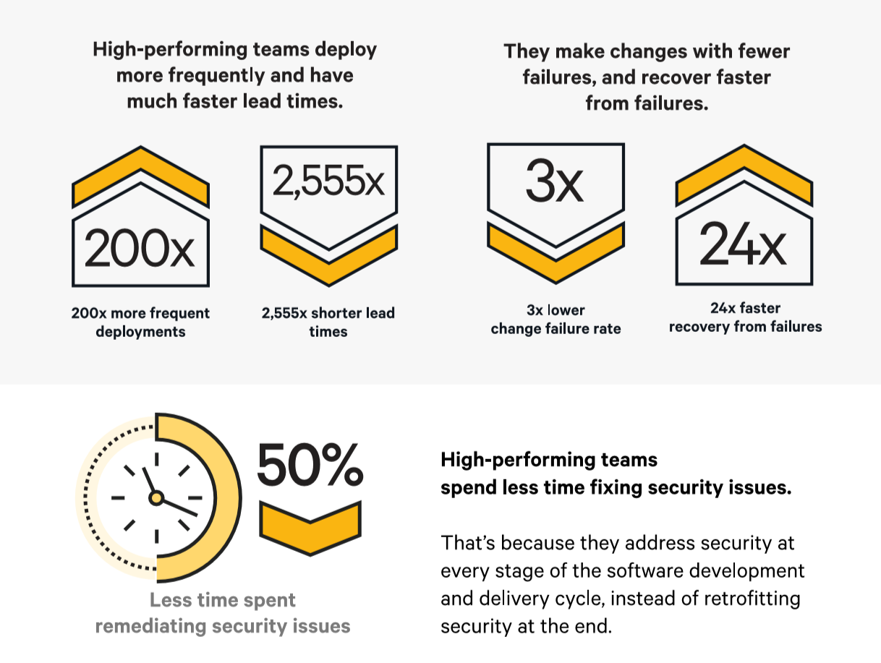

Slide 6
CULTURE
AUTOMATION
METRICS
SHARING
DEVOPS

Slide 7
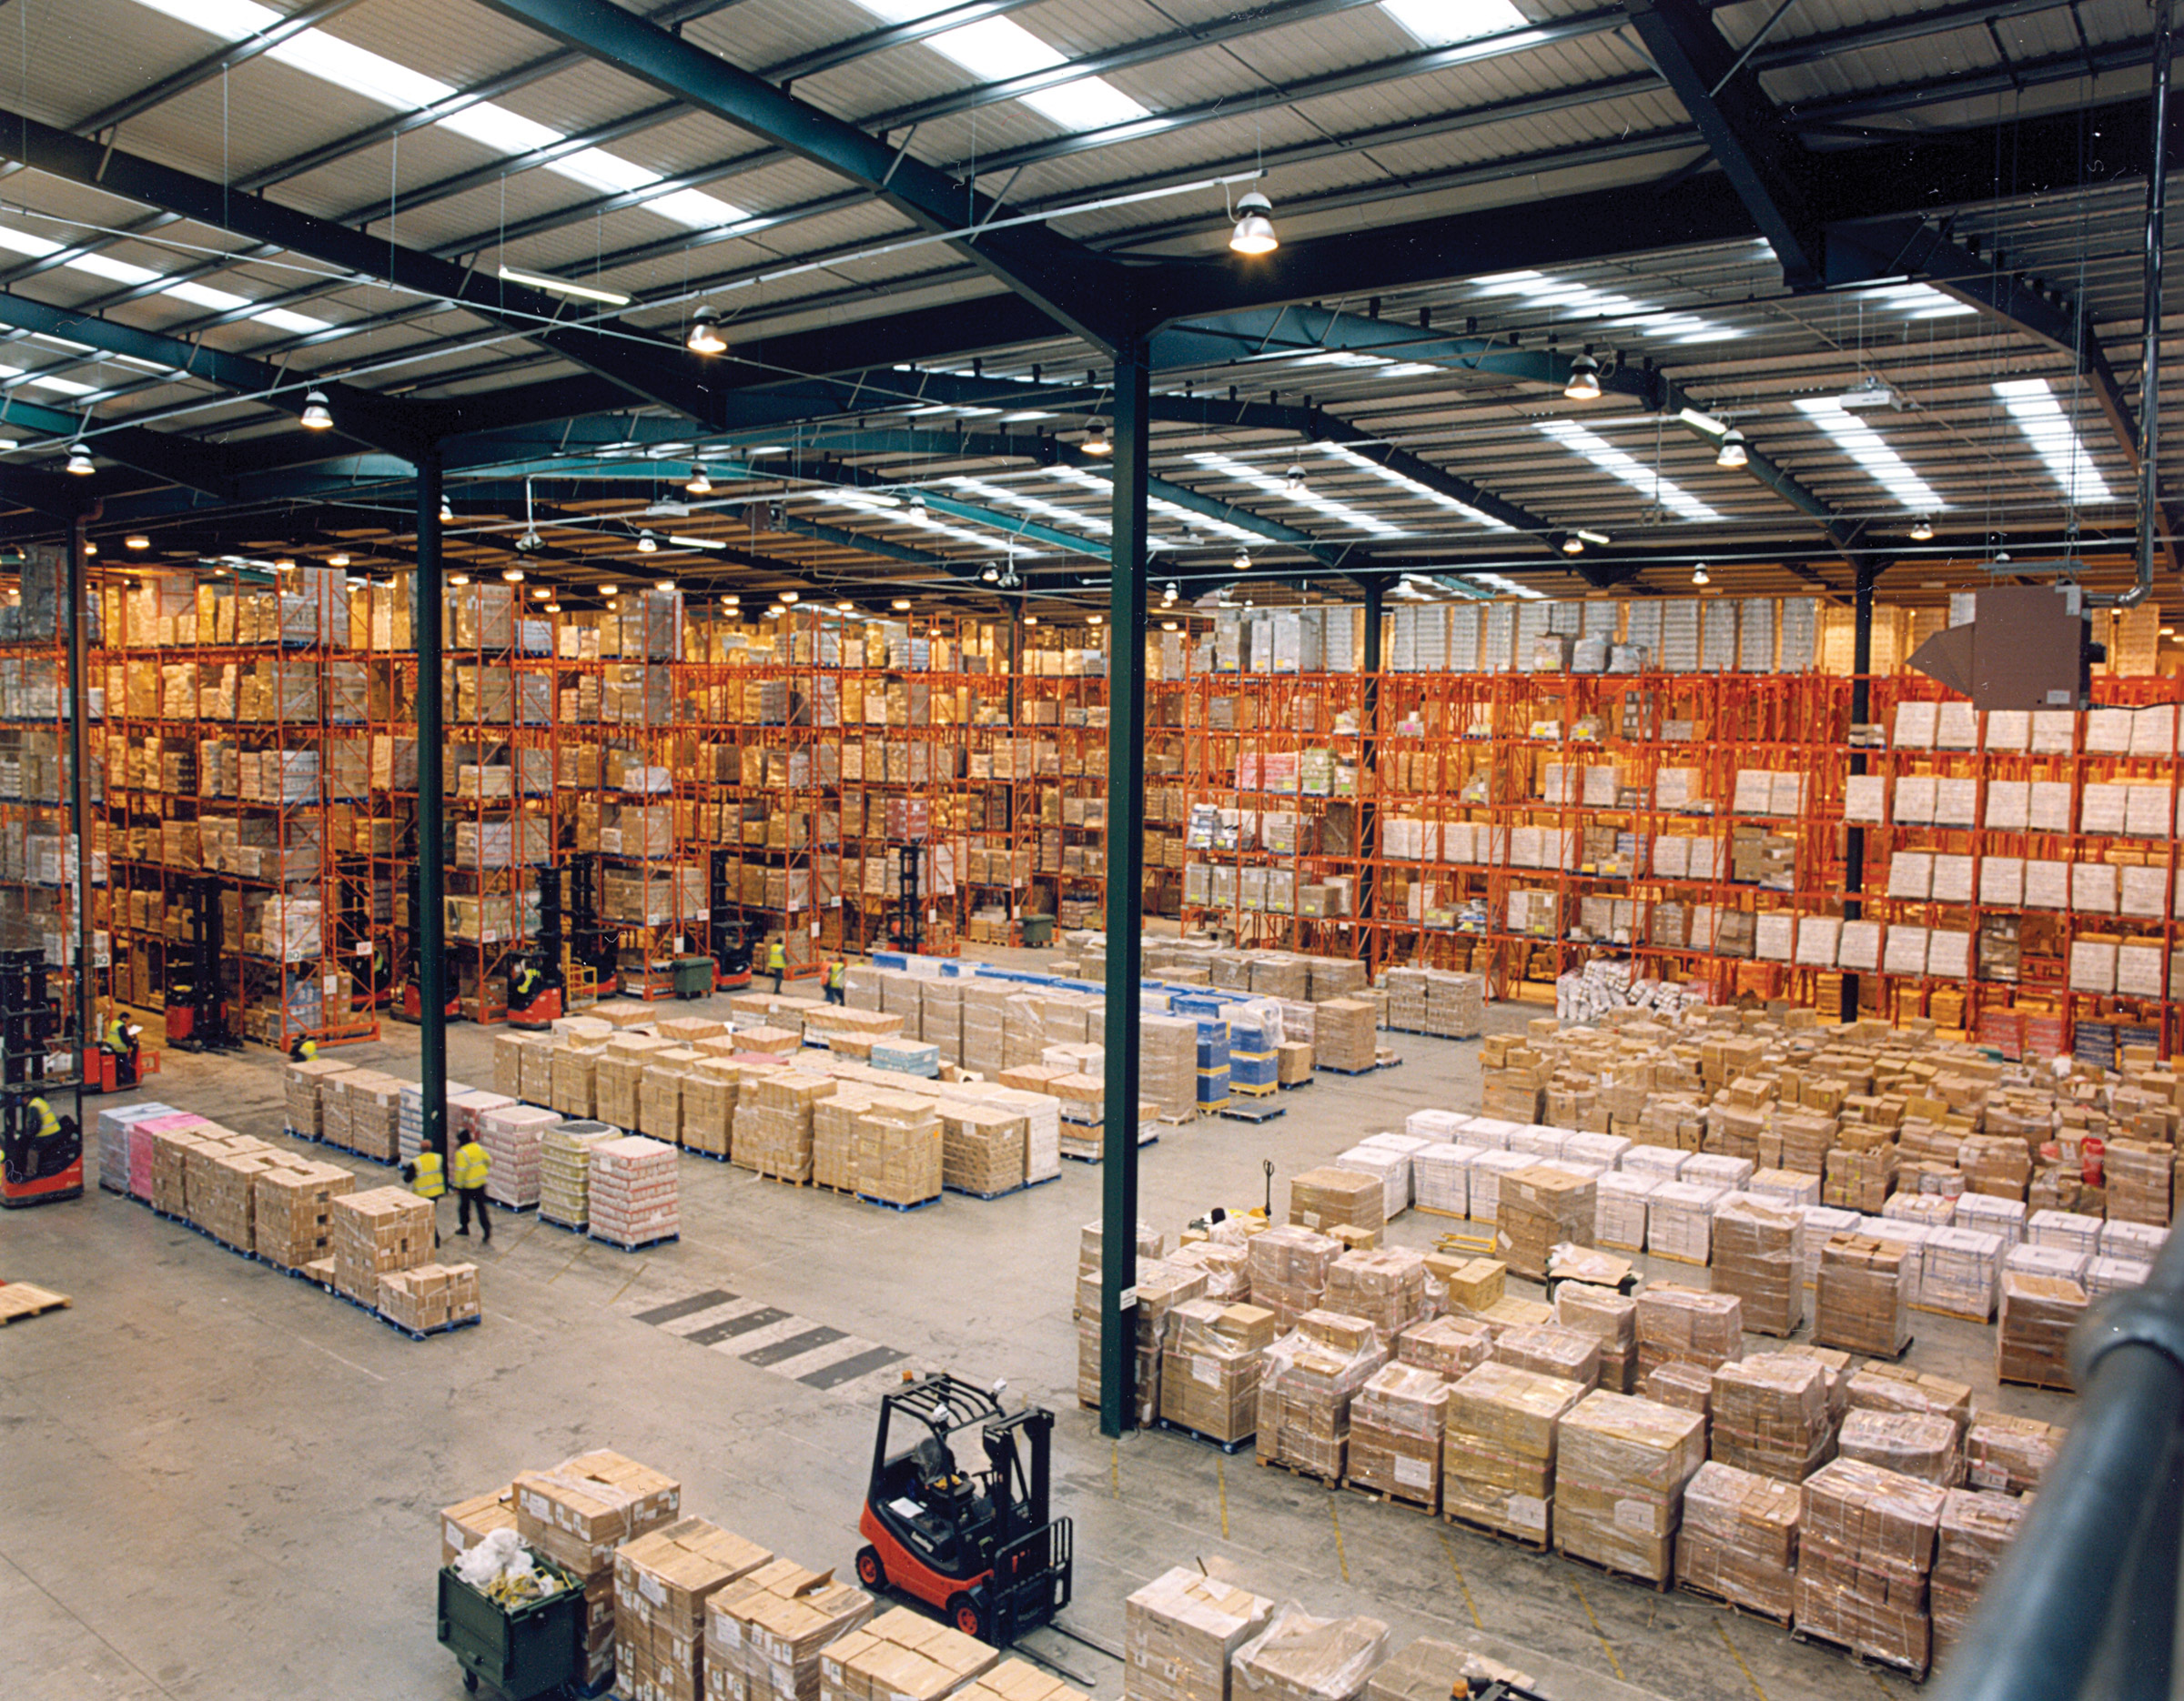
https://en.wikipedia.org/wiki/Logistics

Slide 8
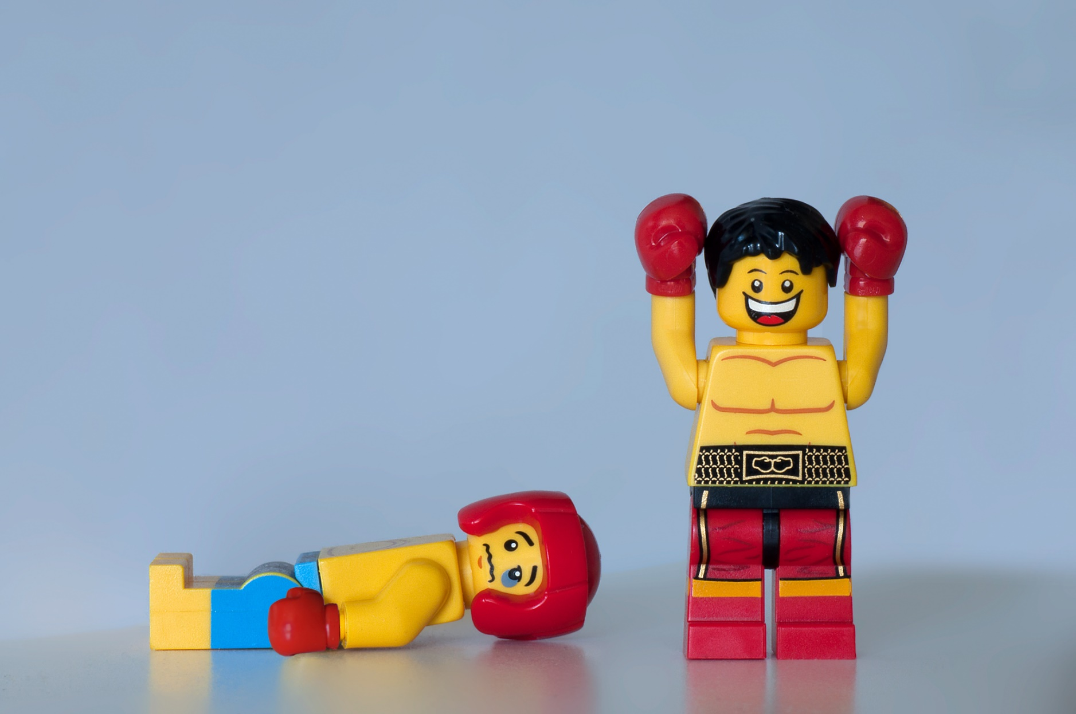
https://www.flickr.com/photos/vanf/6124579928

Slide 9
DevOps Maturity
Basic
Source Control
Branching and Merging
Advanced
Deployment Maturity
Agile Project Planning
Environments
Logging
Intermediate
Library of Releases
Dependency Management
Configuration Management
Automation
Versioning Strategy
Database Change Management
Decoupling / Async Strategy
Build Server

Slide 10
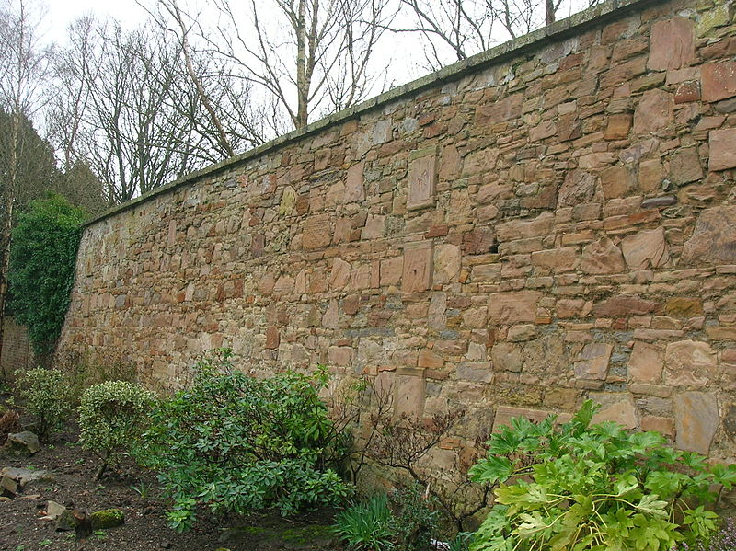
https://commons.wikimedia.org/wiki/File:Eglinton_Walled_garden_wall.JPG

Slide 11















Slide 12
.NET to Docker
Convert to .NET Core
Replace Libraries
Deploy
Configure Correctly
File -> New Project
Create New Builds
Containerize
Build Your Container
VM running Docker
Container-as-a-Service
Grab .NET Core Container
Fronting Service

Slide 13
Dockerfile
FROM microsoft/dotnet:1.0.0-preview2-sdk
EXPOSE 8080
ENV ASPNETCORE_URLS http://0.0.0.0:8080/
RUN mkdir /src
COPY src /src
RUN cd /src && dotnet restore
ENTRYPOINT cd /src/Services/MyVote.Services.AppServer.Core && dotnet run

Slide 14
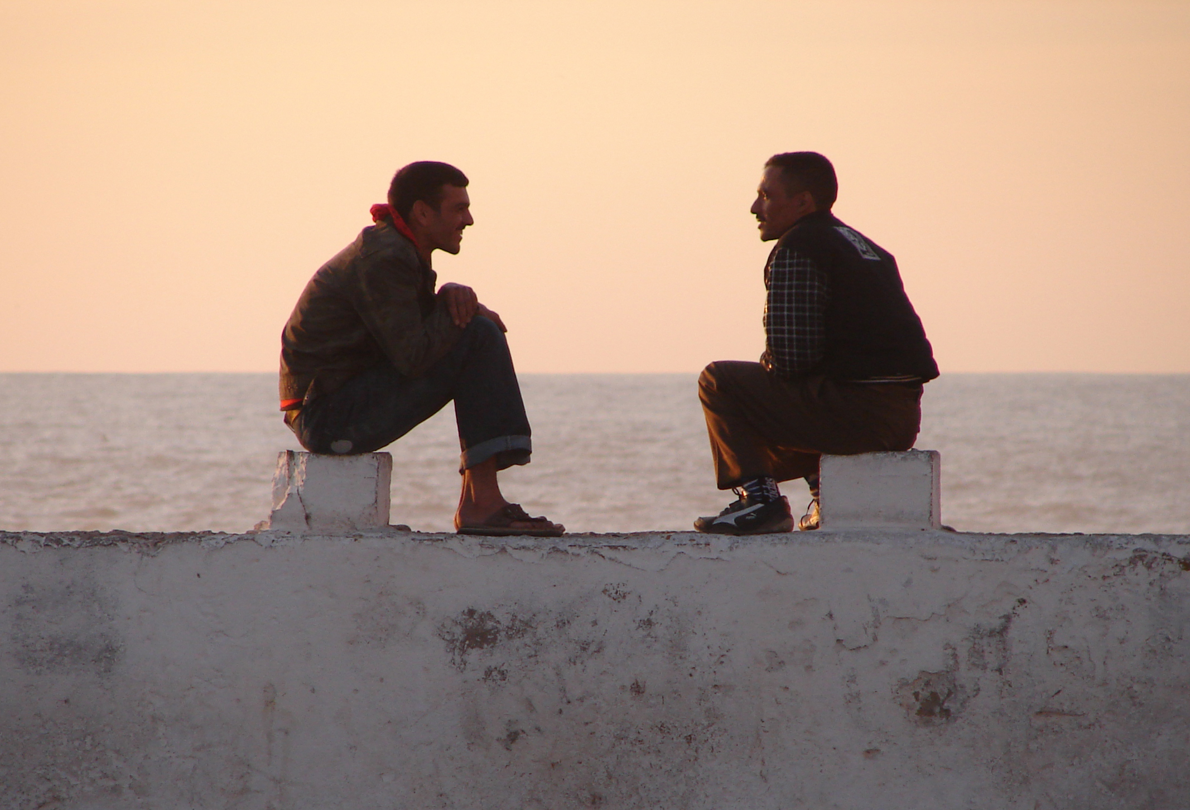
https://commons.wikimedia.org/wiki/File:Meeting_On_The_Wall,_Essaouira_(5258780850).jpg

Slide 15
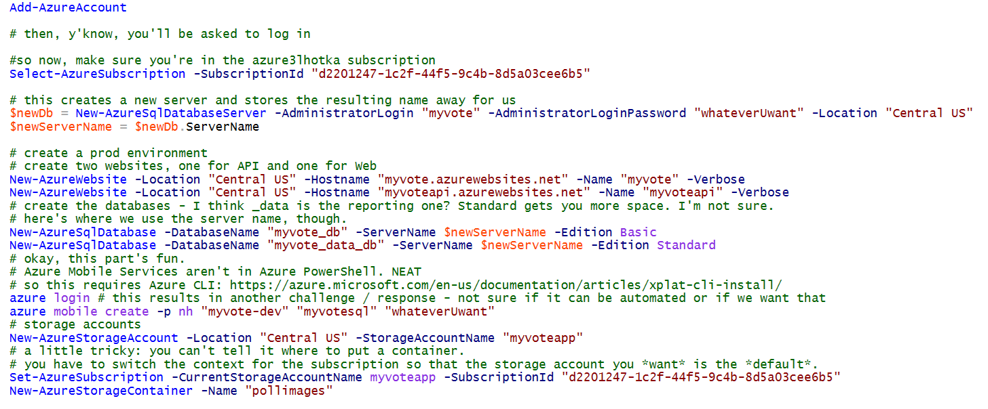
Infrastructure as Code

Slide 16
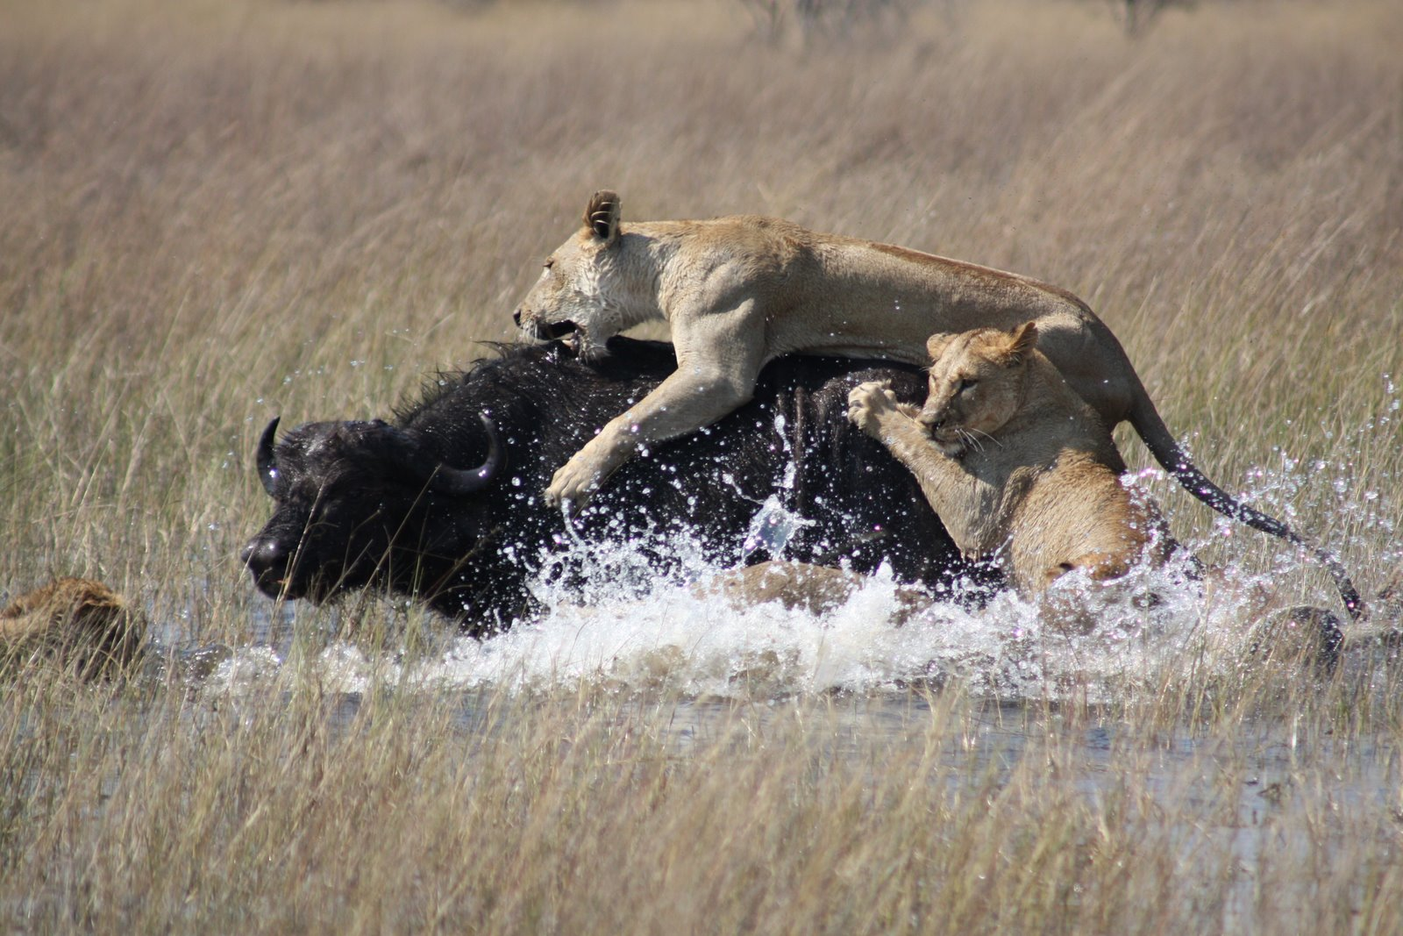
https://en.wikipedia.org/wiki/Cooperative_hunting

Slide 17
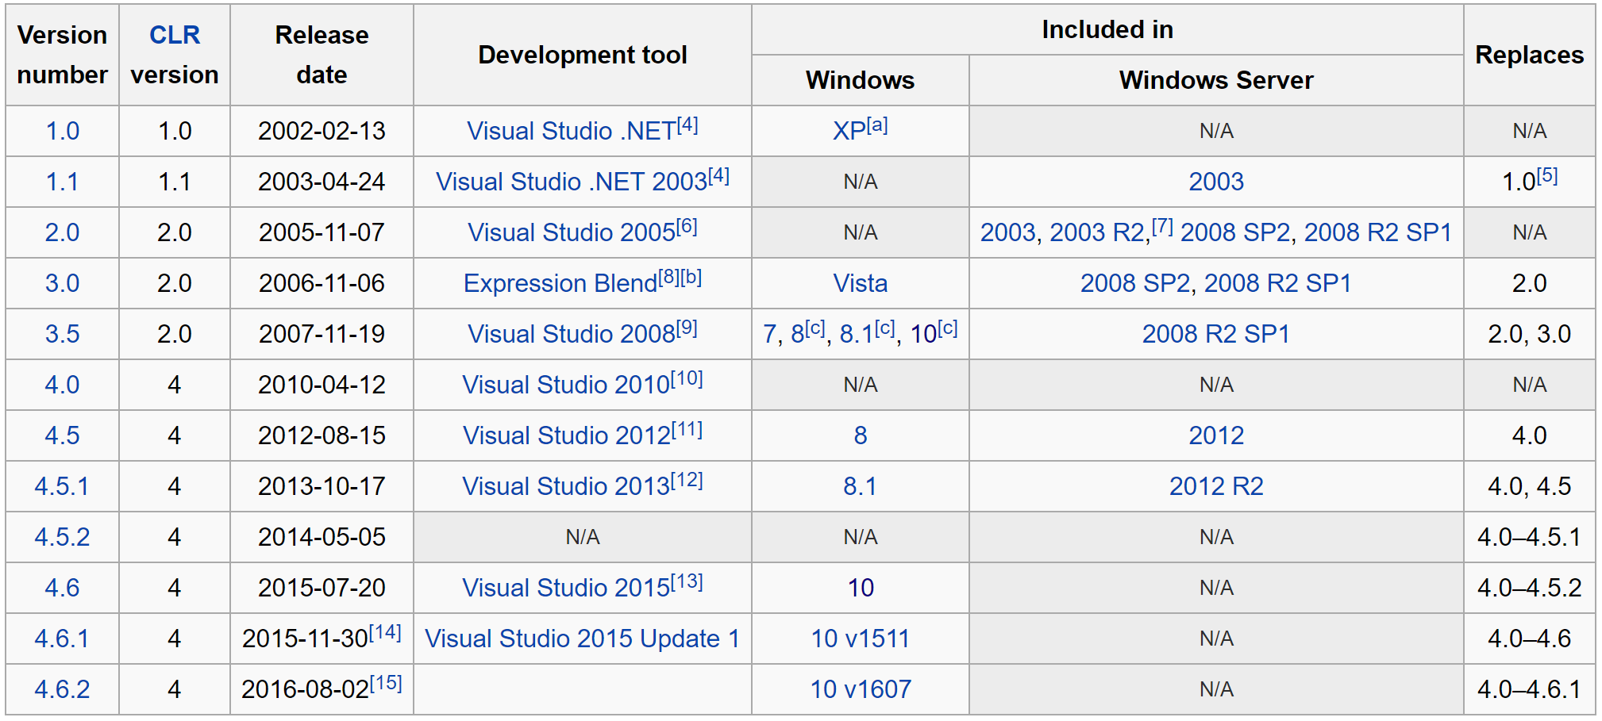
.NET Framework

Slide 18

https://pixabay.com/en/wicker-palm-surface-wallpaper-164100/

Slide 19
THANK YOU
Remember your evaluations!

